Slide 1
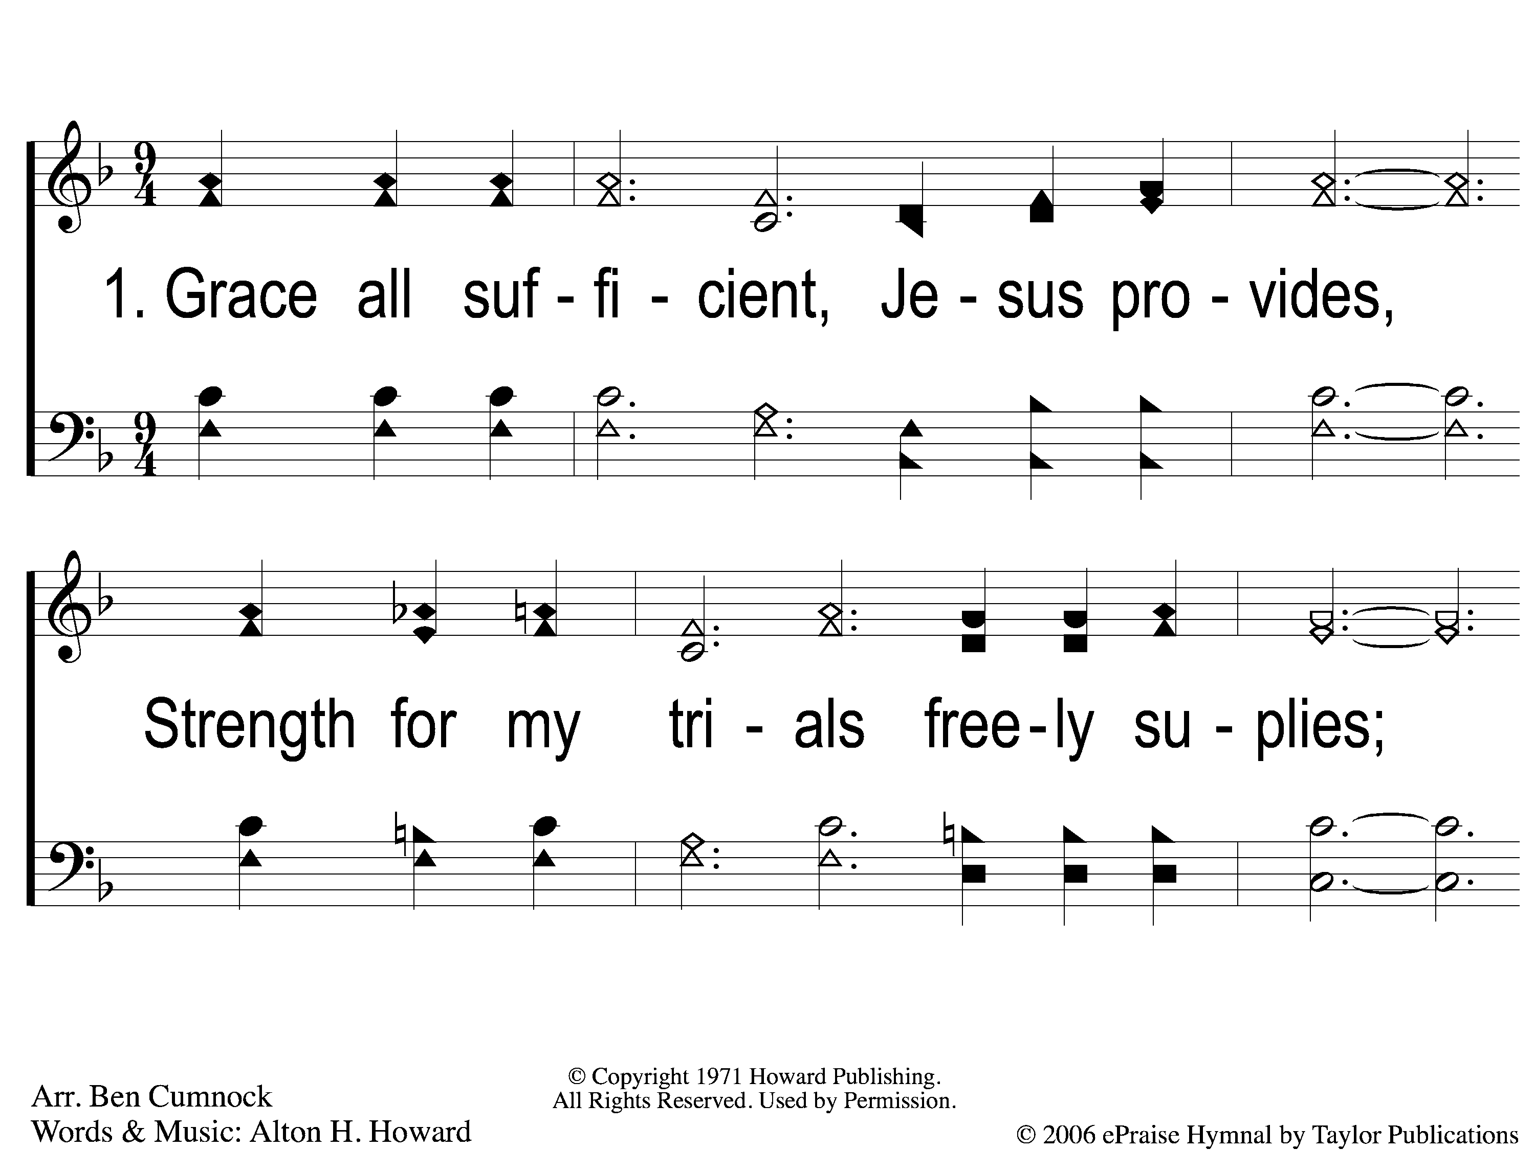
1-1 Grace All Sufficient
Grace All Sufficient
144

Slide 2
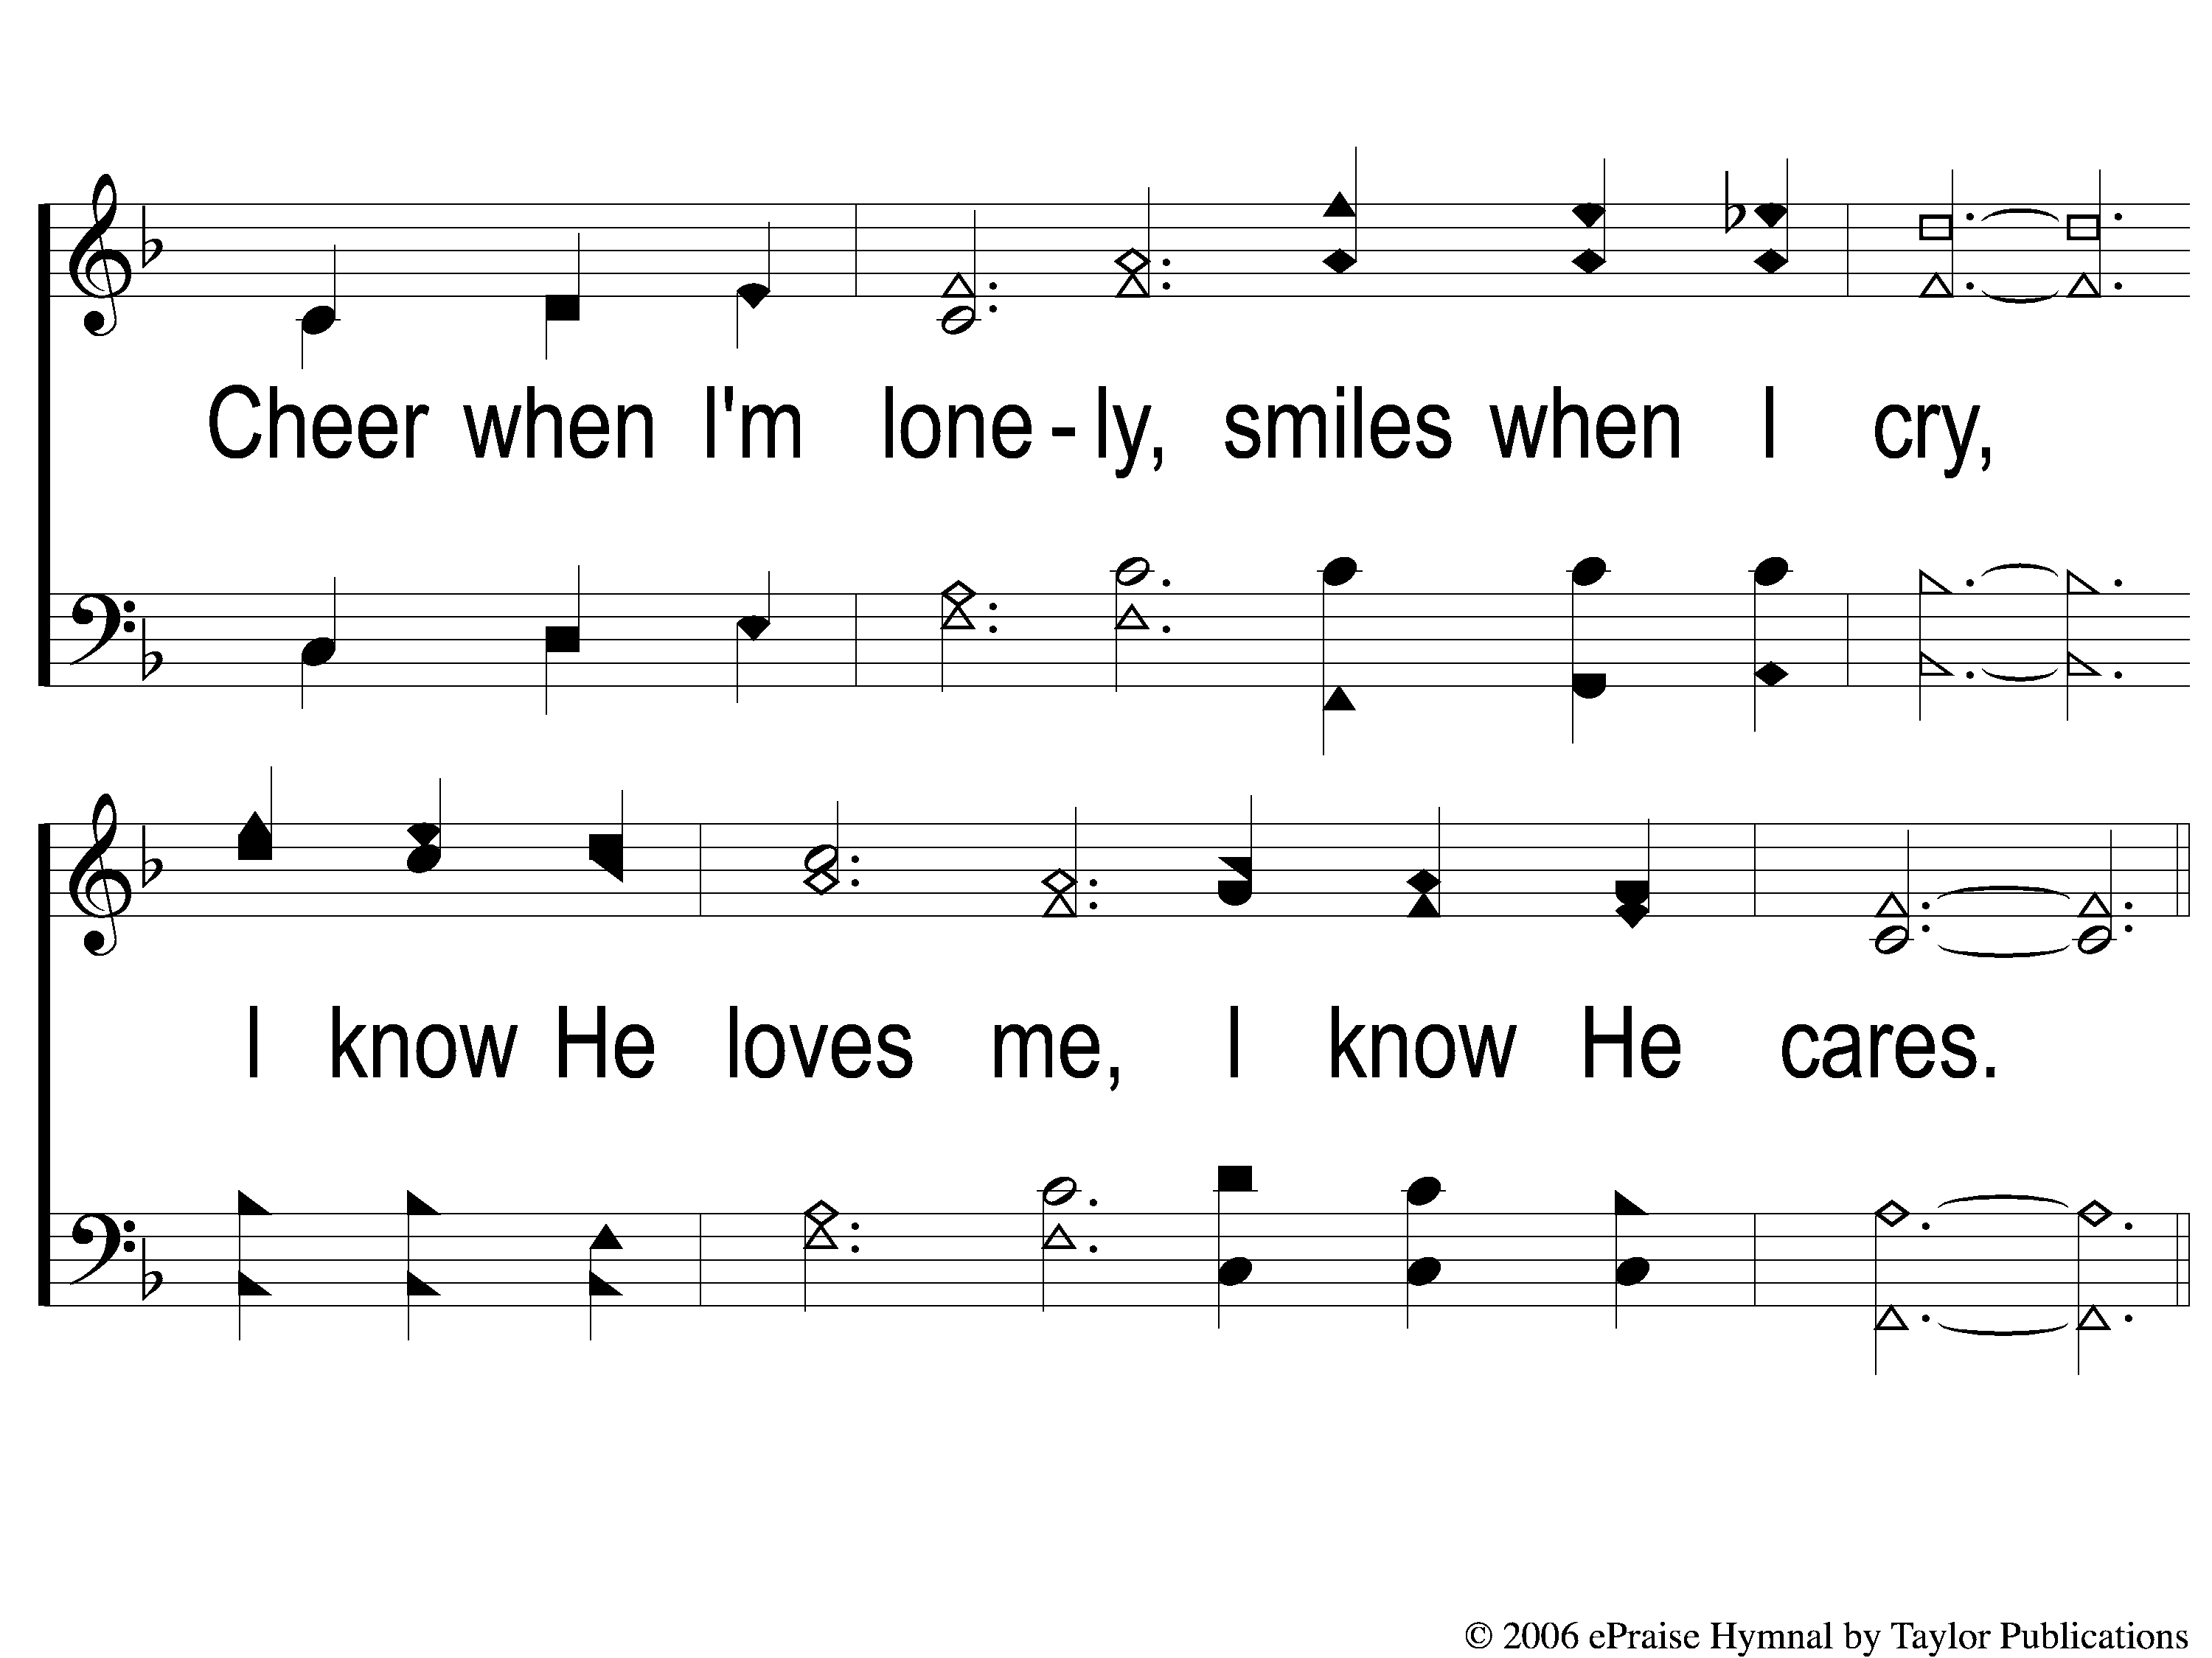
1-2 Grace All Sufficient
Grace All Sufficient
144

Slide 3
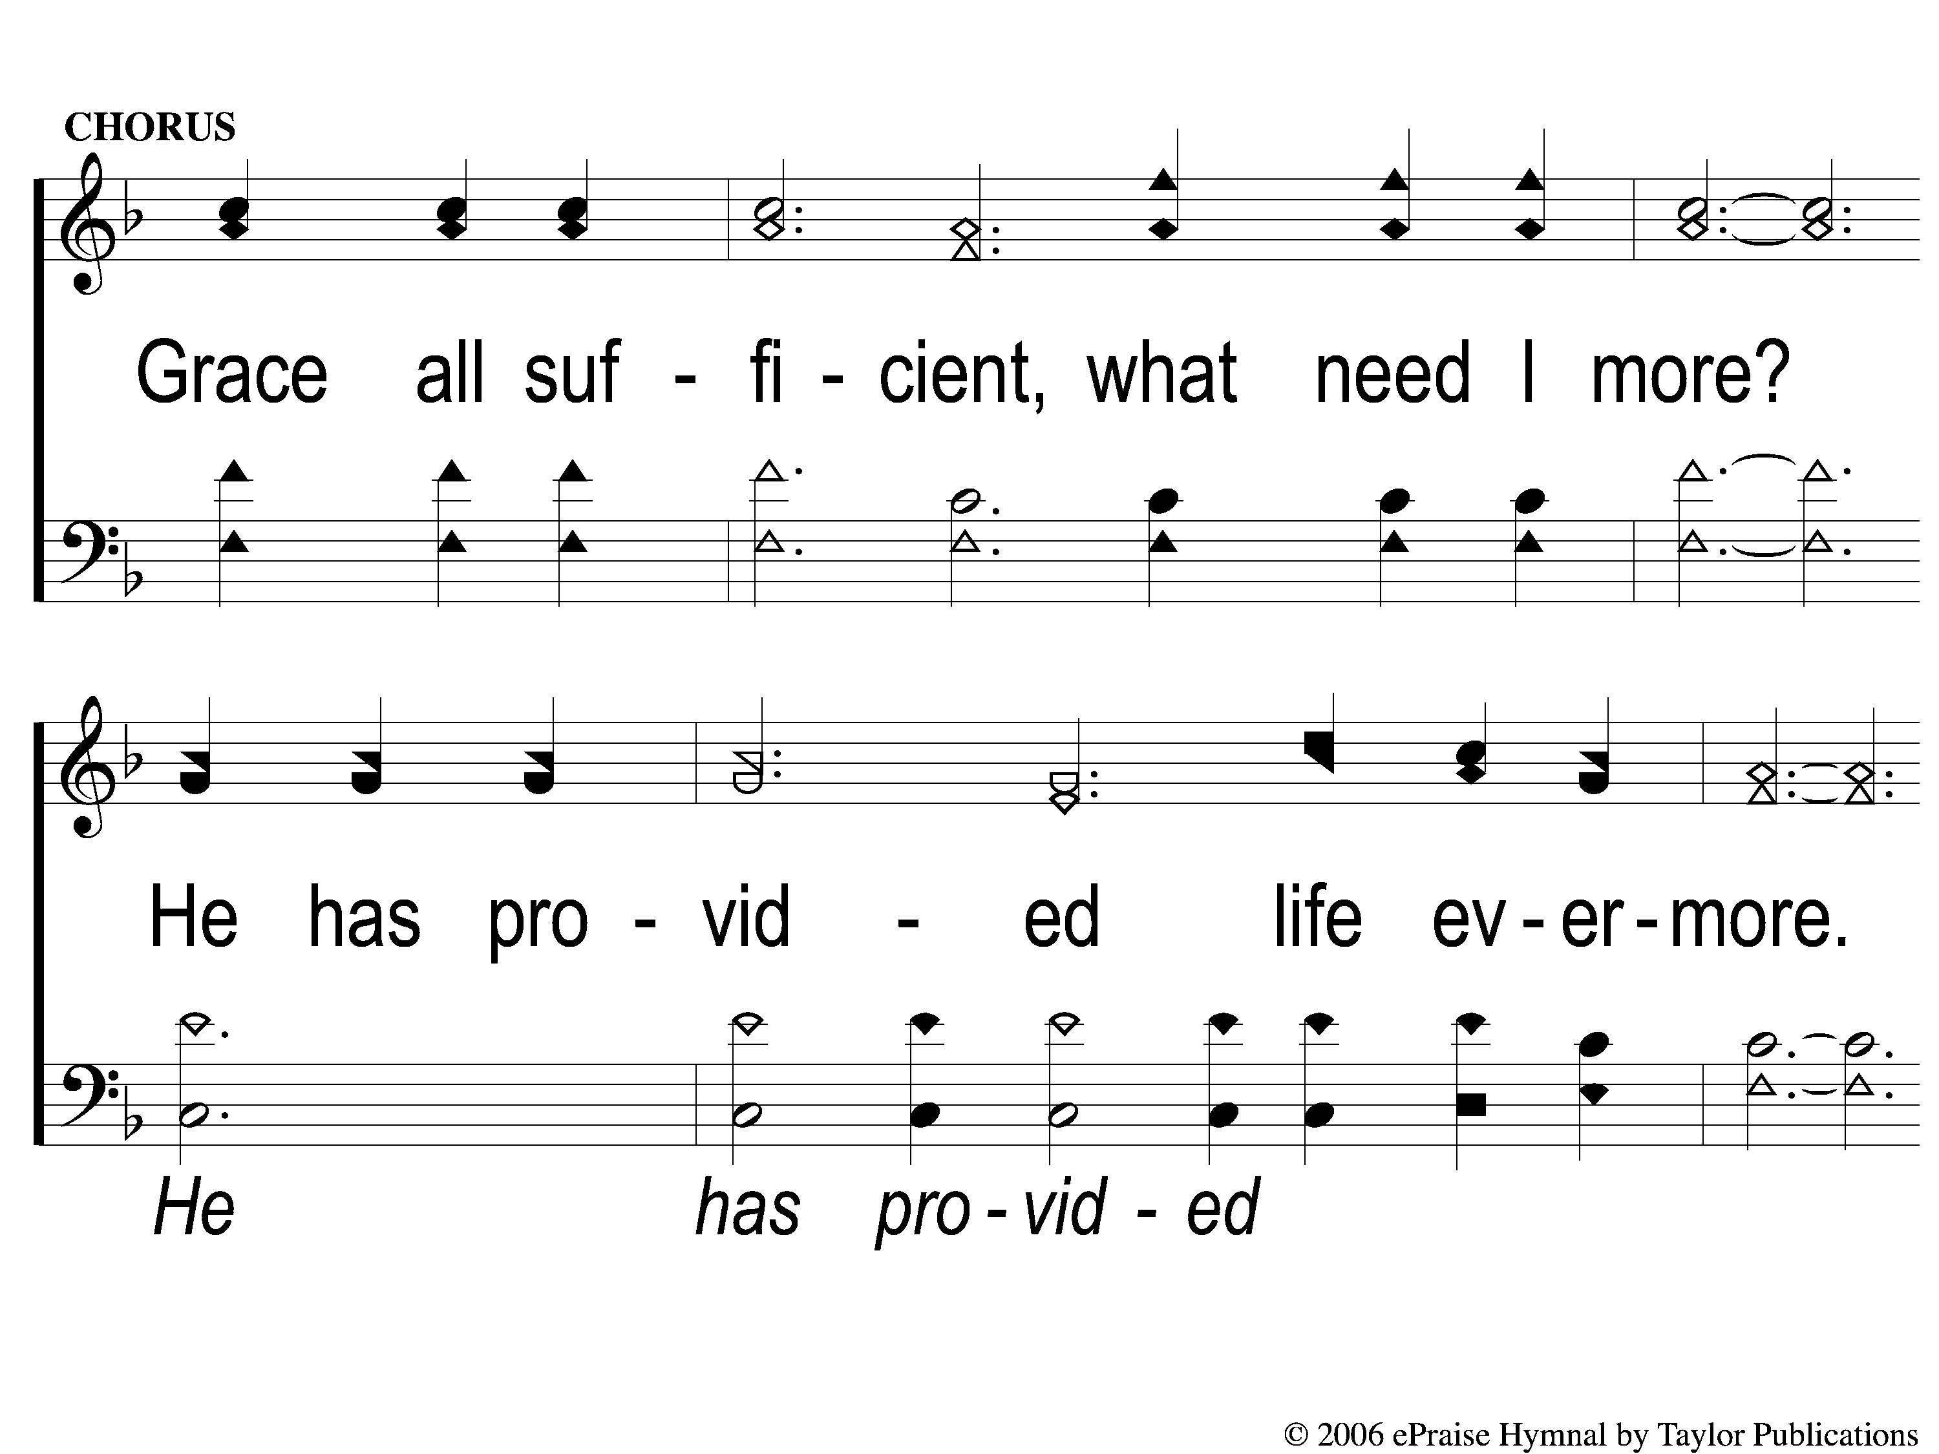
C-1 Grace All Sufficient
Grace All Sufficient
144

Slide 4
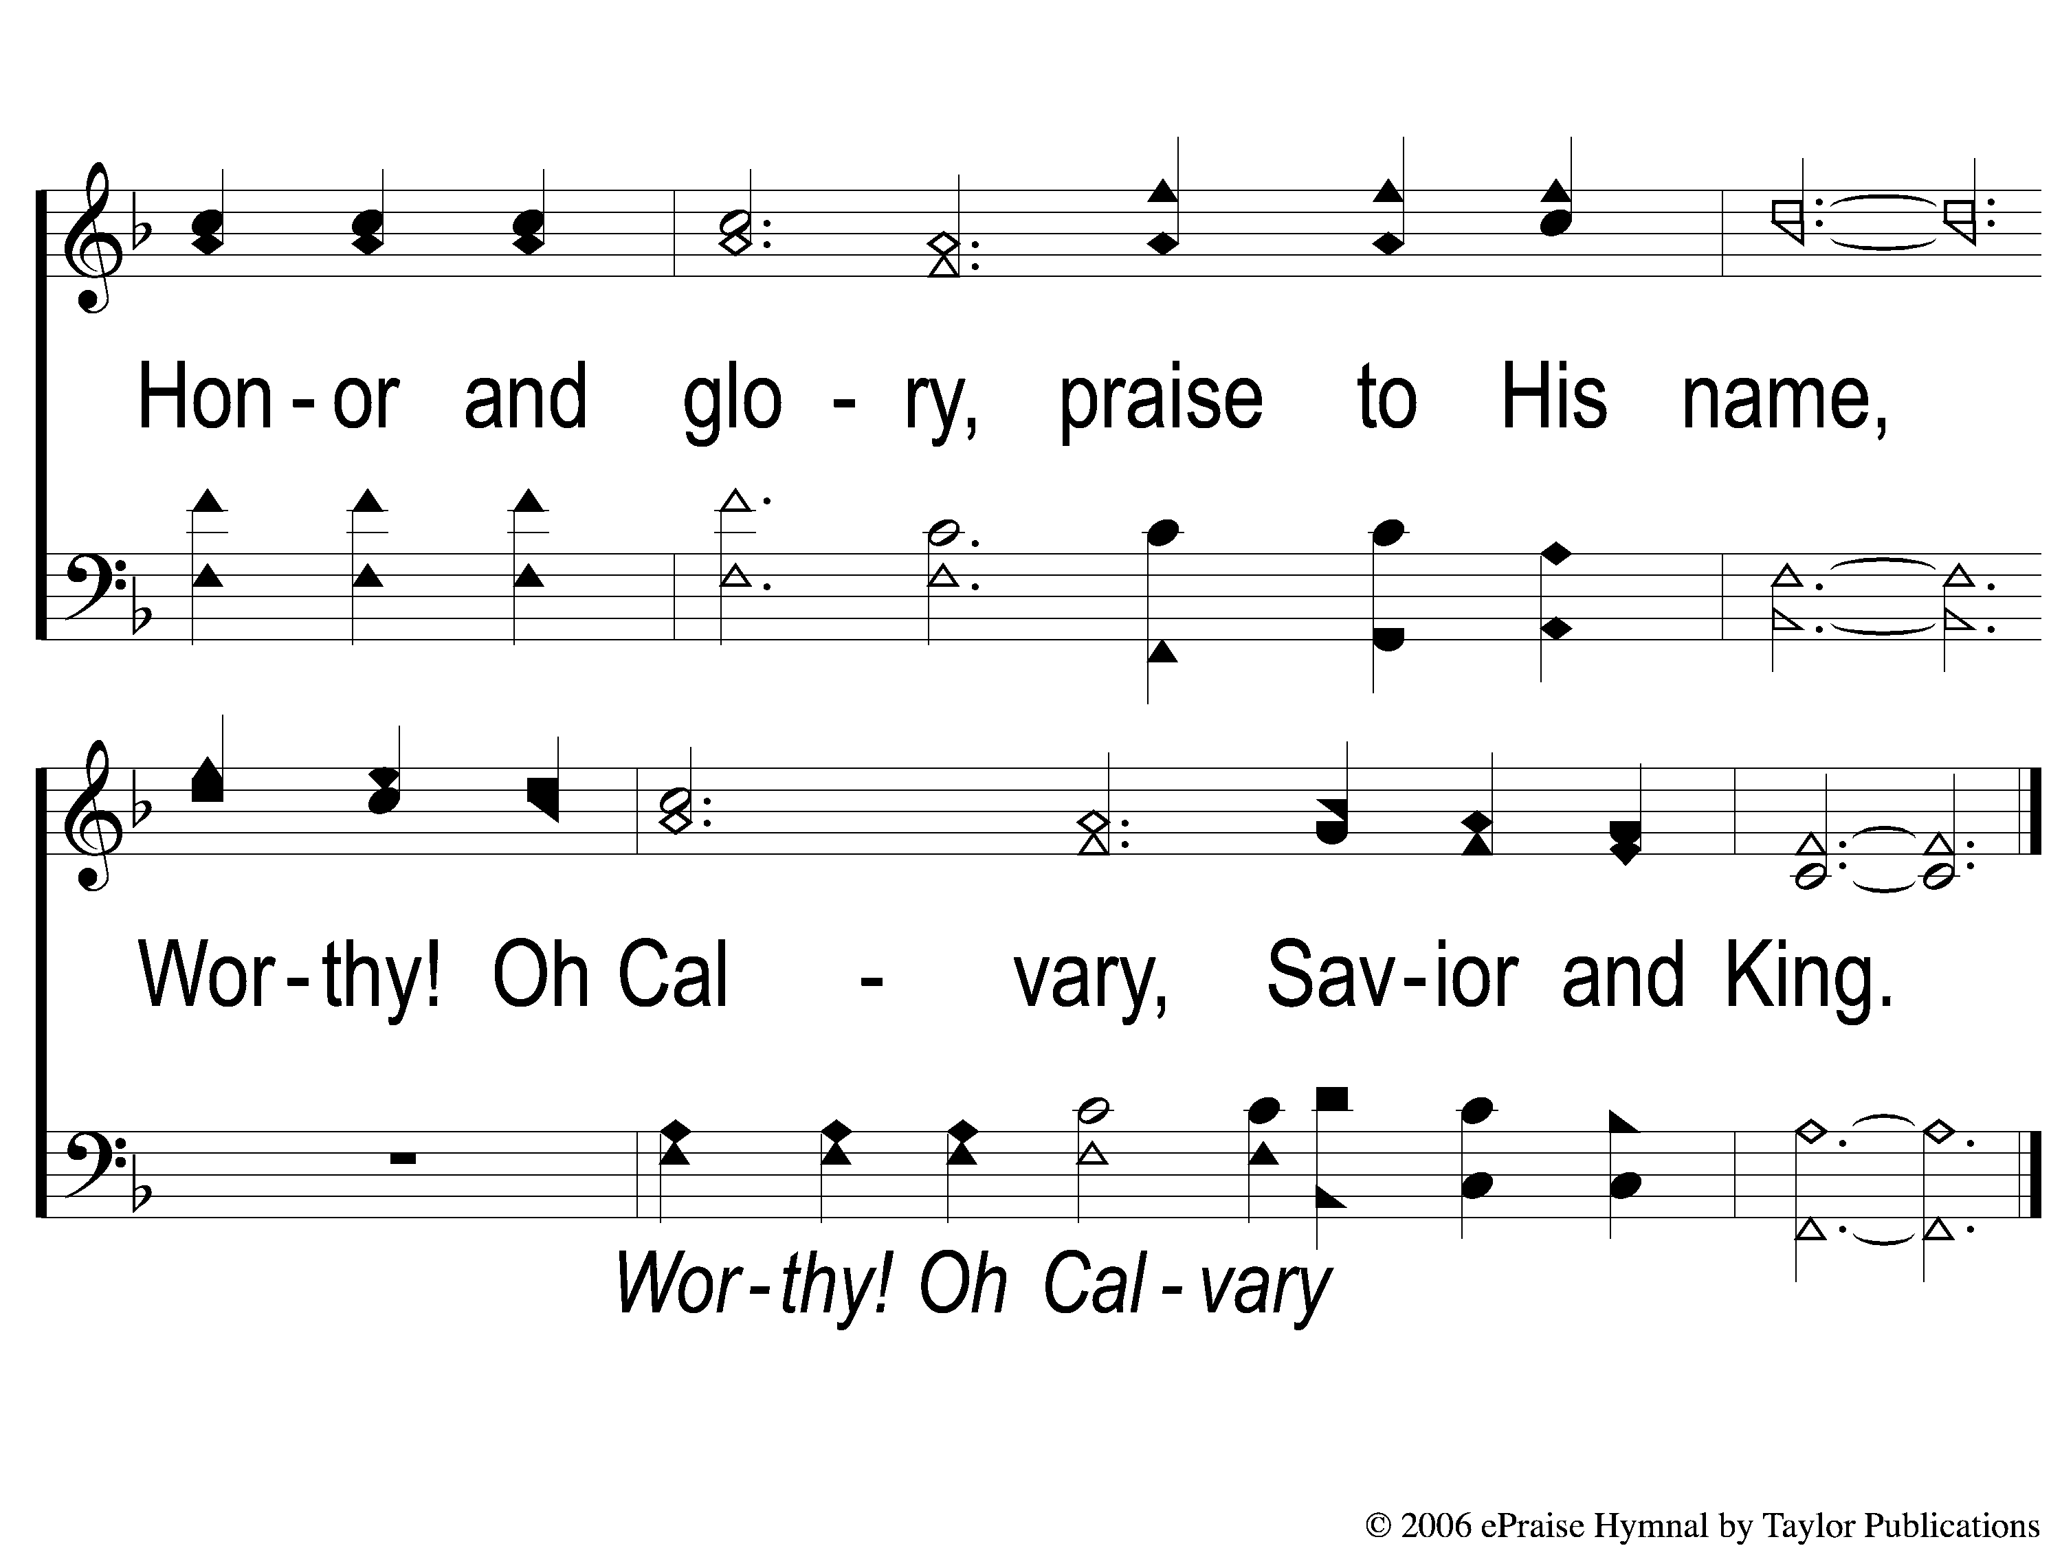
C-2 Grace All Sufficient
Grace All Sufficient
144

Slide 5
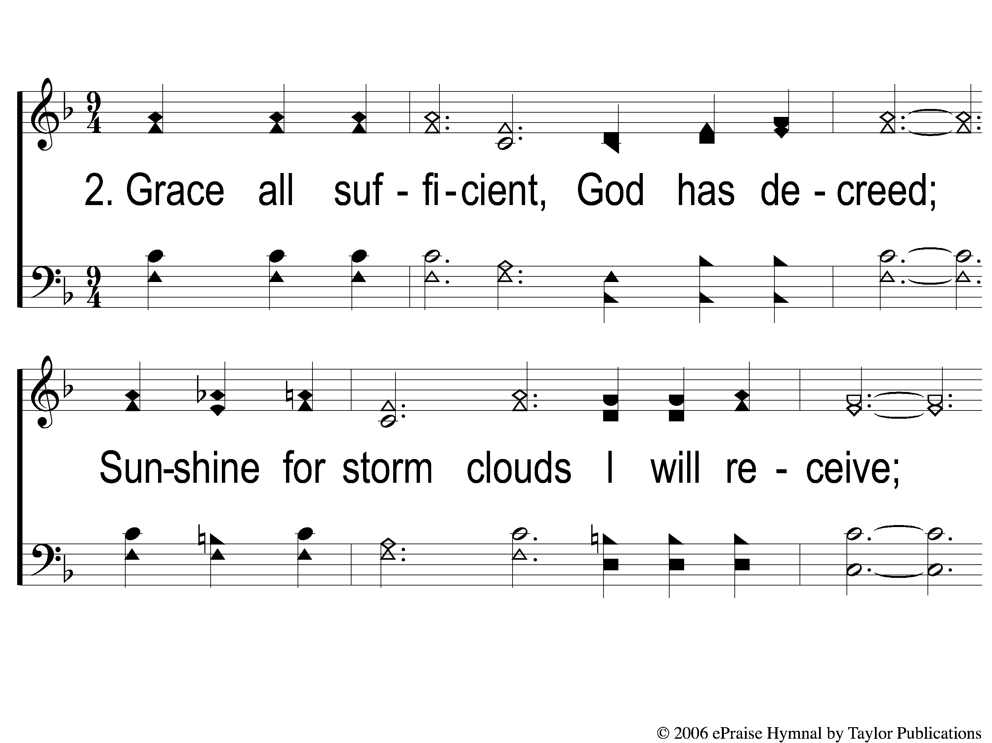
2-1 Grace All Sufficient
Grace All Sufficient
144

Slide 6
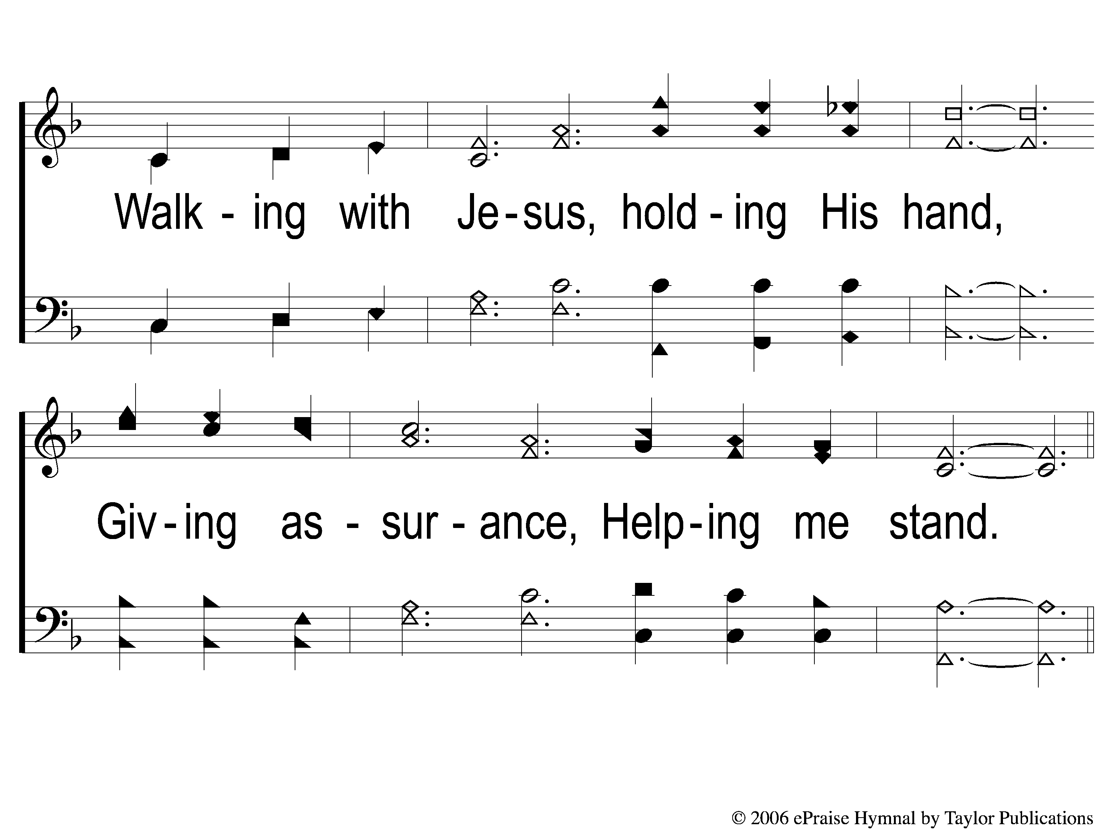
2-2 Grace All Sufficient
Grace All Sufficient
144

Slide 7
C-1 Grace All Sufficient
Grace All Sufficient
144

Slide 8
C-2 Grace All Sufficient
Grace All Sufficient
144

Slide 9
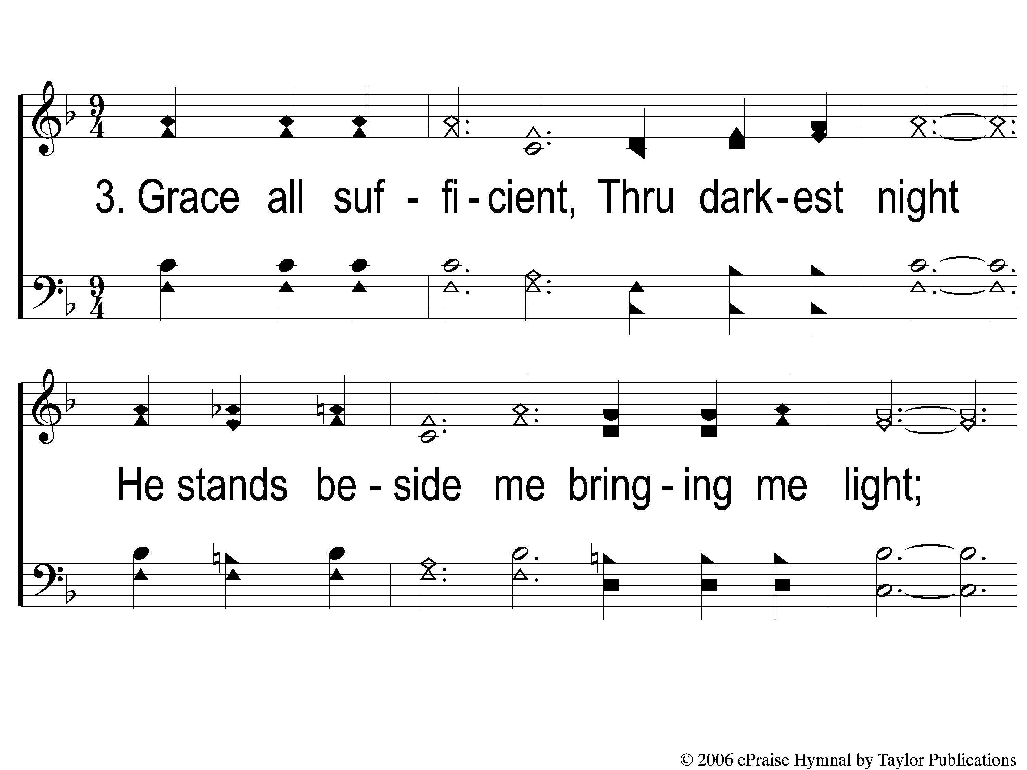
3-1 Grace All Sufficient
Grace All Sufficient
144

Slide 10
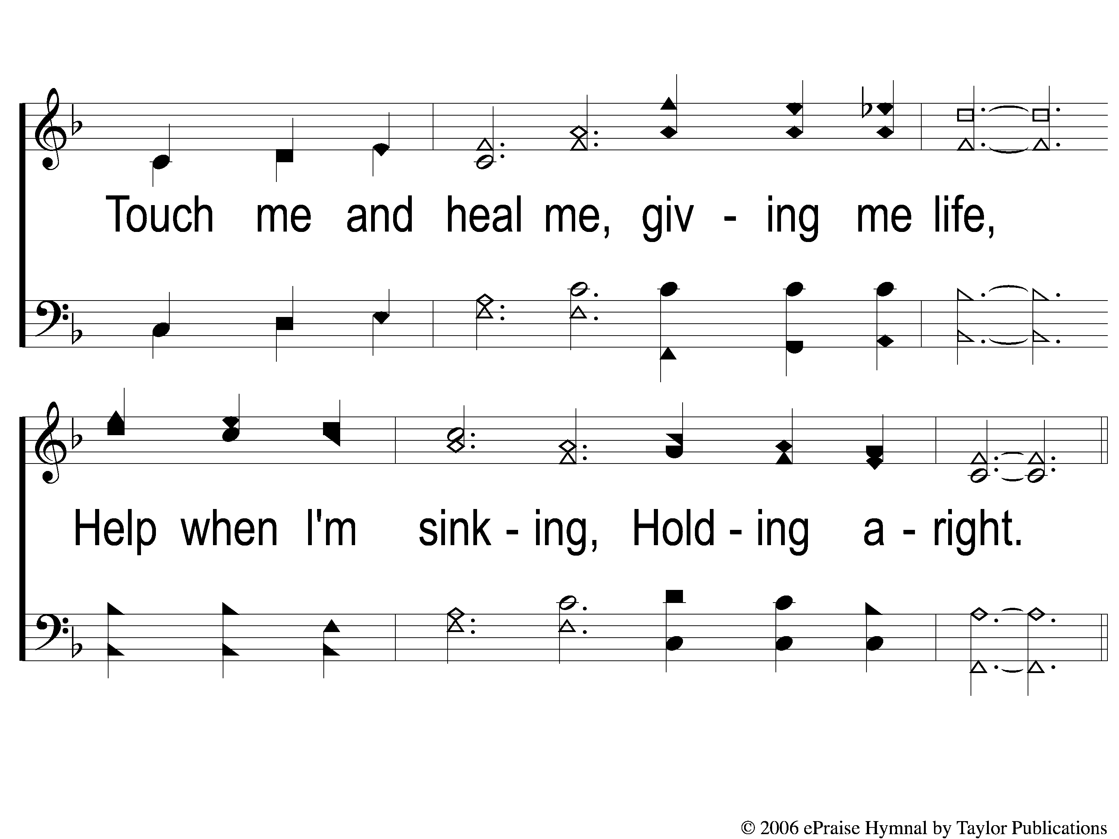
3-2 Grace All Sufficient
Grace All Sufficient
144

Slide 11
C-1 Grace All Sufficient
Grace All Sufficient
144

Slide 12
C-2 Grace All Sufficient
Grace All Sufficient
144

